Slide 1
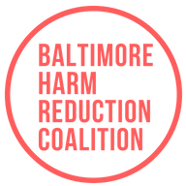
Advocating for
Harm Reduction:
It’s Really Not Controversial
Maryland Peer Summit, May 2019
Tricia Christensen, Advocacy Coordinator
Lisa Pace, Harm Reduction Regional Ambassador

Slide 2

Who are we?
Baltimore Harm Reduction Coalition mobilizes community members for the health, dignity, and safety of people targeted by the War on Drugs and anti sex worker policies. We advocate for harm reduction as part of a broader movement for social justice.

Slide 3
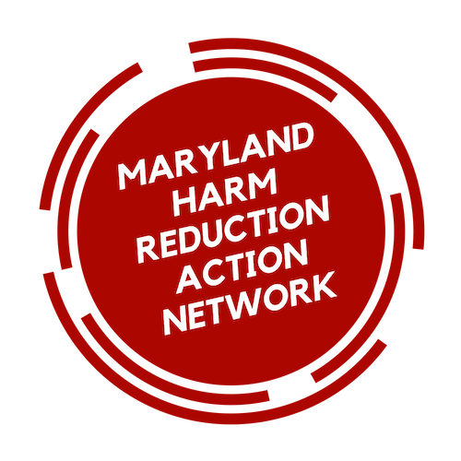
Who are we?
We accept that people often use licit and illicit drugs for their benefits, and drug use can range from being helpful and positive to chaotic and dangerous.
We acknowledge the real harms and danger that may incur from drug use, and that people may experience problems related to mental health, sex work, and homelessness which can further complicate their drug use.
We recognize that social inequity, racial injustice, and oppressive public policy magnify harm and suppress the voices of communities most targeted and affected by the War on Drugs.
We defend the right of people who use drugs and their allies to participate in the public policy dialogue.
The Maryland Harm Reduction Action Network consists of individuals and organizations committed to promoting the health, dignity, and safety of people who use drugs by educating about, advocating for, and promoting the use of harm reduction principles.

Slide 4
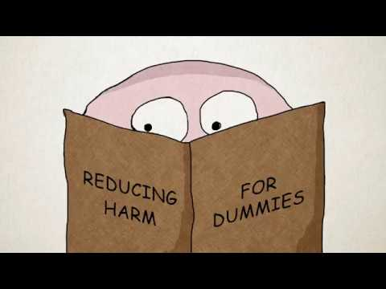
Checking in…
Notes:
- Raise your hand if you’re familiar with “harm reduction”
- Keep your hand up if you could give a definition of “harm reduction”

Slide 5
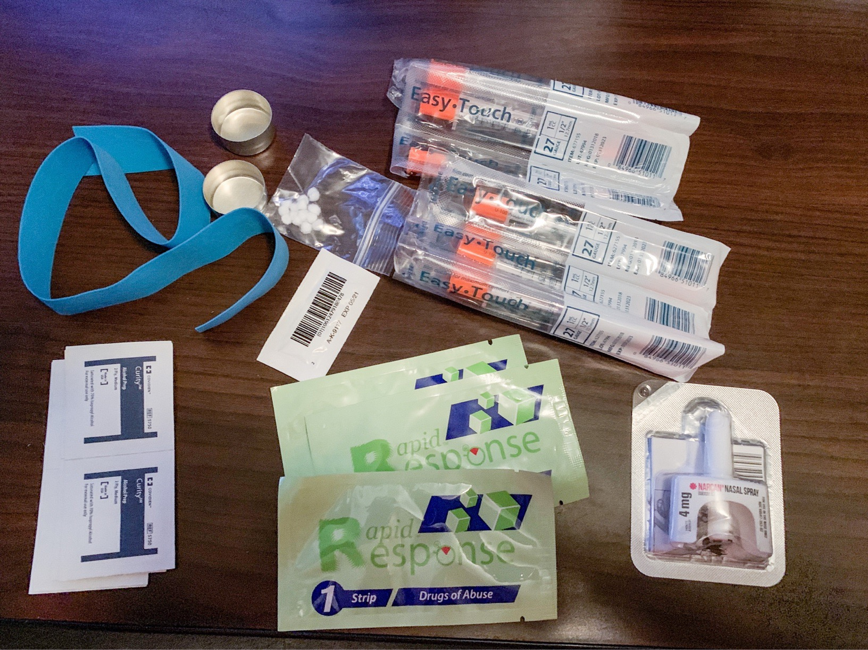
RISK REDUCTION:
A set of practical strategies and ideas to reduce negative consequences associated with drug use.
Often discussed in terms of programs/tools that support people who use drugs
Notes:
Like naloxone, syringe access, and fentanyl test strips

Slide 6
Harm Reduction is more than just risk reduction
A movement for social justice built on the belief in, and respect for, the rights of people who use drugs.
Originally started by drug users for drug users
“
Both recovering people and active users were critical in getting needle exchange going and maintaining it today. Sometimes, that connection lit the spark of recovery; other times, it just helped people get through another day without becoming infected. Almost always, it gave people hope. – Maia Szalavitz
Notes:
Human rights!
It was also PWUD who started community naloxone distribution – naloxone was being used by paramedics and in hospitals; it was active drug users who fought to get naloxone into the hands of PWUD and their closest allies

Slide 7
Harm Reduction is realistic
Seeks to reduce the harms inflicted on people by drug prohibition which makes underground drug use dangerous and deadly – it’s a resistance to the failed War on Drugs.
Understands that there will never be a drug-free society.
Defines “success” as increased quality of life / wellness
  Not simply as abstinence from drugs

Slide 8
Harm Reduction as a peer
Peer Principle: Acceptance - Certified Peer Recovery Specialists accept all pathways to recovery however diverse, even those opposite to their own
Our experiences might look very different.
Recovery coaches help people move toward wellness based on their strengths and needs, without judgement.
Notes:
LISA

Slide 9
Harm Reduction as a peer
Our relationship is built on trust. Making a space that is safe and provides dignity and compassion is critical in establishing trust.
We must say to people who use drugs – Your life is valuable and your being alive is the most important thing right now in this moment.
Use of peer services is a form of harm reduction
Notes:
Lisa

Slide 10
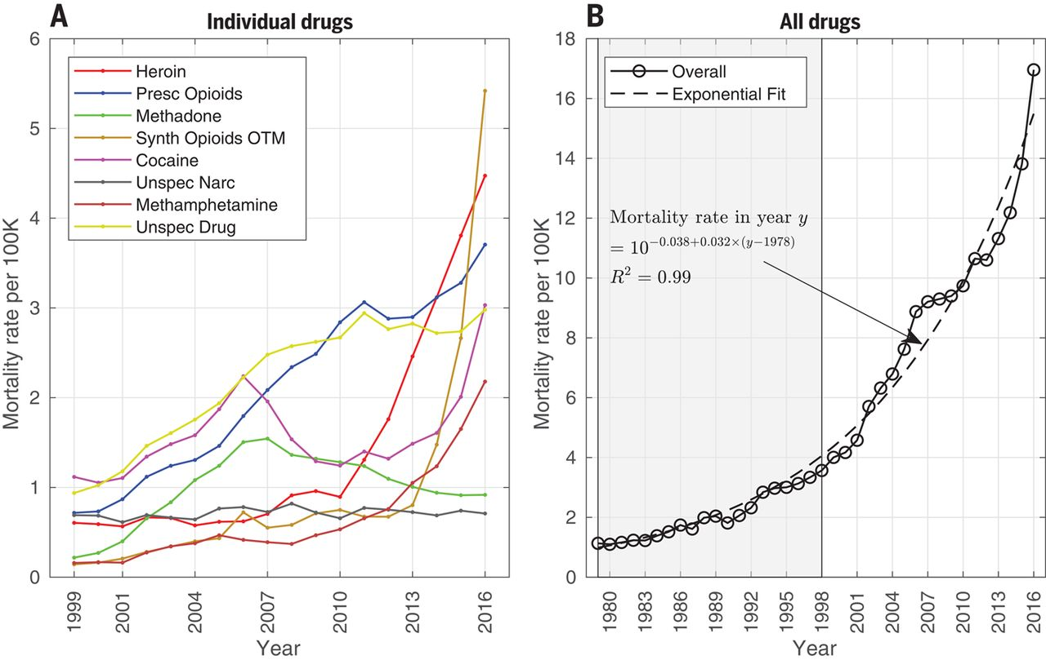
Why advocate for Harm Reduction?
Beyond the “opioid crisis,” we must talk about overdose
Jalal et al., Science 361, 1218 (2018)
Notes:
If all funding/programs tied to opioids, they will dry up once a new drug comes on the scene

Slide 11
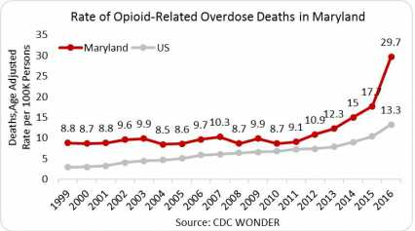
Why advocate for Harm Reduction?
The opioid overdose fatality rate in Maryland has consistently been above the national average since 1999, ranging 1.5 to 3 times the average rate.

Slide 12
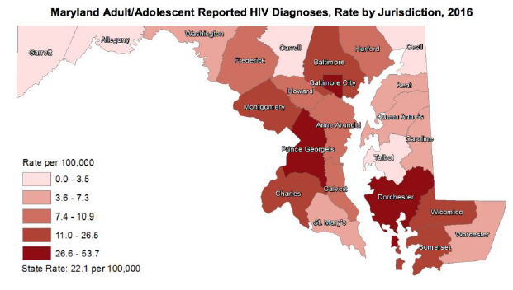
Why advocate for Harm Reduction?
30,000+ Maryland residents are living with HIV
1 in 4 contracted HIV via injection drug use
CDC. HIV Surveillance Report.
Notes:
1 in 4 contract HIV via injection drug use – if they don’t have consistent access to syringes, they are more likely to share

Slide 13
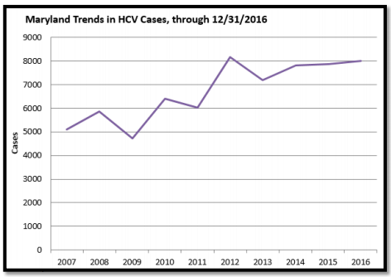
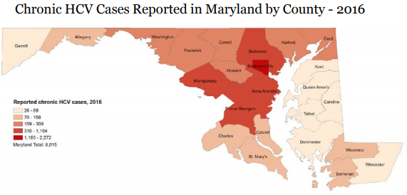
Why advocate for Harm Reduction?
Hepatitis C incidence is rising, and is known to be underreported – actual acute estimates are estimated to be 13.9 times the number of reported cases in any year.
Maryland’s NEDSS. Cases of Selected Notifiable Conditions Reported in Maryland in 2016

Slide 14
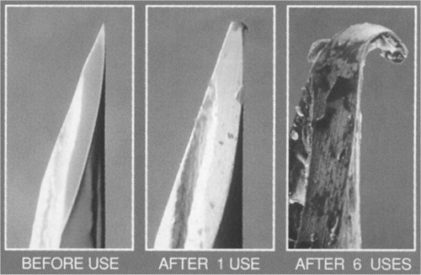
Why advocate for Harm Reduction?
Skin and soft tissue infections (SSTI) are the most common cause for hospital admission of people who inject drugs.
Endocarditis occurs when bacteria, fungi, or other germs enter the blood stream and travel to the heart.
Notes:
Not shown: the bacteria that is living on the surface which is then pushed into the bloodstream

Slide 15
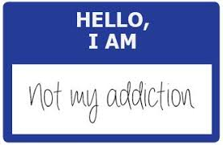
Why advocate for Harm Reduction?
We must talk about people who use drugs
Drug use is common! SUD is rare.
Only ~10% of people who report drug use develop a SUD at some point in their lives
Most people resolve problematic drug use naturally (without formal treatment or recovery supports)
Notes:
Not just “people with opioid use disorder” or “people in recovery”

Slide 16
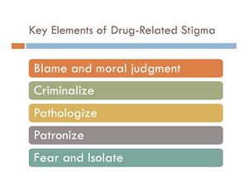
Why advocate for Harm Reduction?
Most people have a poor understanding of drug use.
Bad person
Medicine = still on drugs
Must “hit rock bottom”
Treatment isn’t available on demand & not all treatment is good treatment
Notes:
LISA

Slide 17
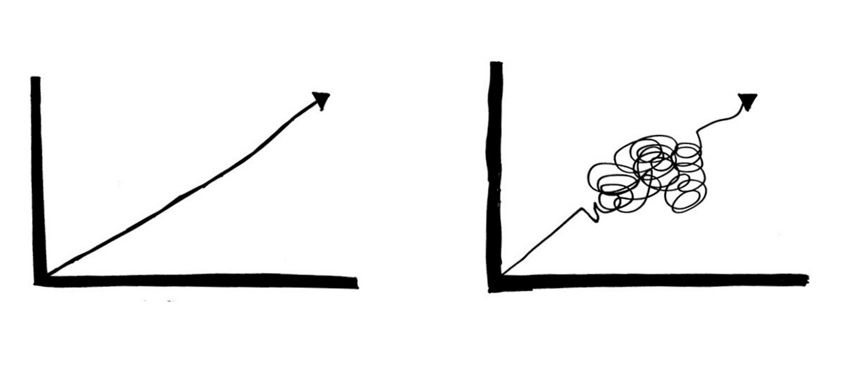
Why advocate for Harm Reduction?
Harm Reduction is recovery.
“A process of change through which individuals improve their health and wellness, live a self-directed life, and strive to reach their full potential.”
--SAMHSA
Notes:
LISA

Slide 18
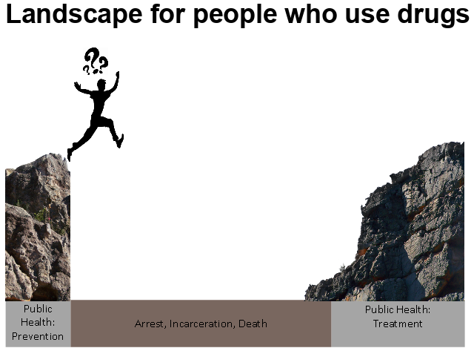
Why advocate for Harm Reduction?
Notes:
Our society tends to invest mostly in Prevention of drug use, and Treatment of drug use

Slide 19
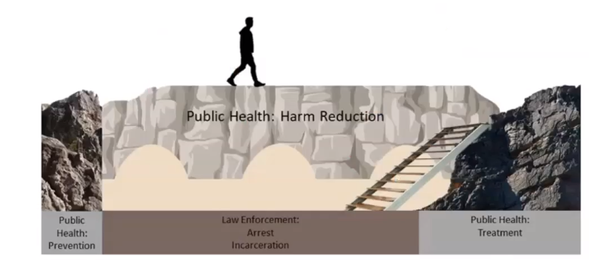
Why advocate for Harm Reduction?

Slide 20
Support for HR policy change in Maryland the last 25 years
(1994) After 3 years of debate in the General Assembly… Baltimore City & Prince George’s County authorized for 1-for-1 needle exchange model (only Baltimore established)
(2014) Authorized to expand to a distribution model
    IDU HIV transmission in 1994 was 60.4%
    In 2016, it was less than 8%
(2014) Good Samaritan law
(2015) Naloxone access: Statewide standing order if trained under ORP
(2016) Syringe Services Program statewide expansion
(2017) Naloxone access: Training requirement removed so anyone can obtain
(2018) Items to “test and analyze” drugs (i.e. fentanyl test strips) decriminalized
(2019) MAT programs in jails required & funded

Slide 21
Other things to advocate for
Local issues:
More naloxone in PWUD hands
Low-barrier MAT
Syringe services
Drug checking
Wound care
Drop-in centers
Arrest diversion
State issues:
Reduce punishment:
  Decriminalize PWUD
Reduce involuntary/coercive interventions
Funding & allowance for different models

Slide 22
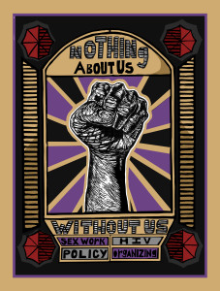
Fundamental to harm reduction
Choice / autonomy
Meet people where they are
People most affected have real voice in policies
“
That’s what all this work is for - to
provide people with a little taste of dignity. Because that can grow into an entire appetite for self-care.
– Cortney Lovell, Young People in Recovery
Notes:
Do the laws and regulations limit what kind of model we can use? We may need to advocate for different kinds of models to increase choice, meet people where they are, and make sure people most affected have a voice

Slide 23
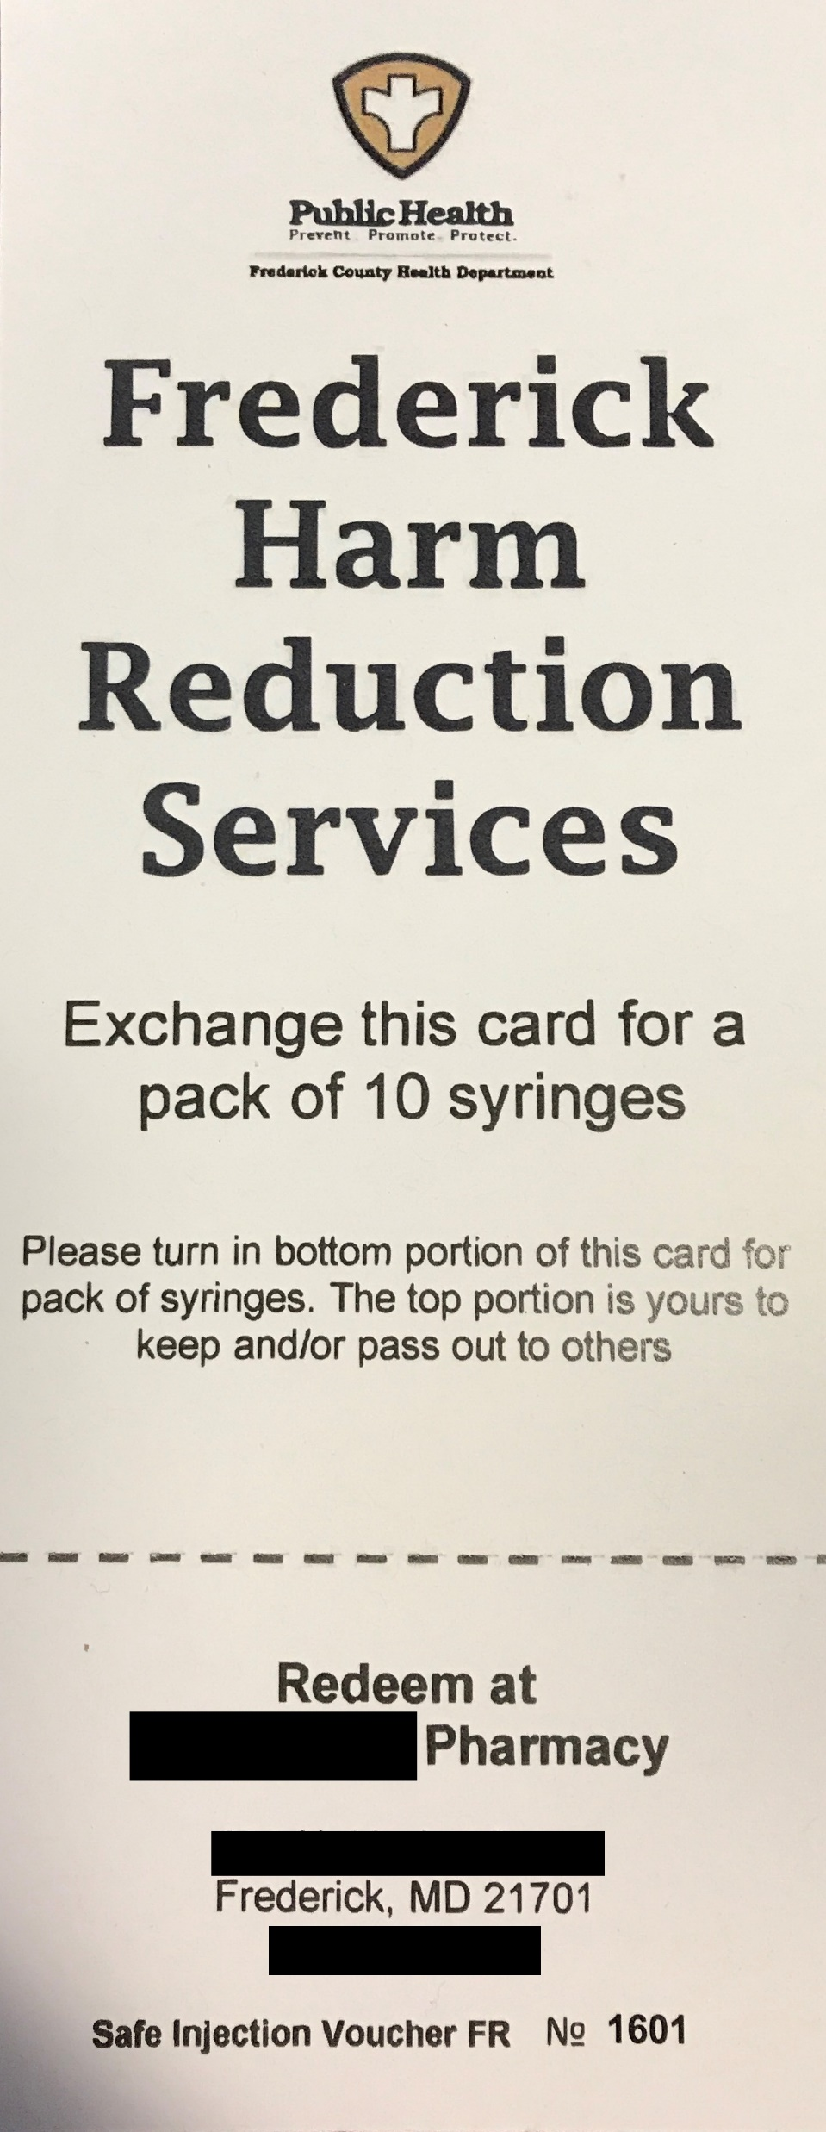
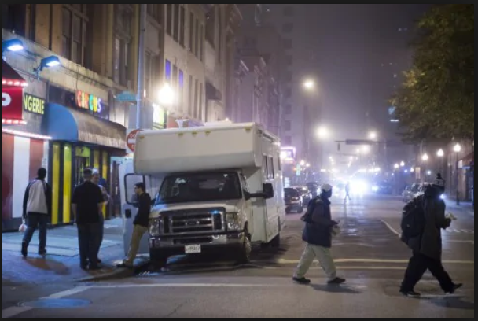
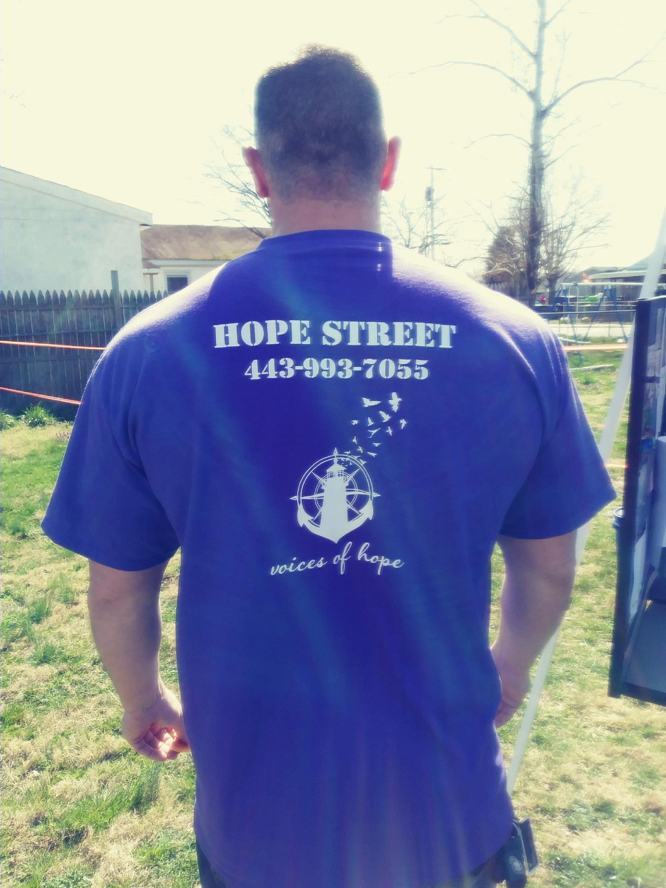
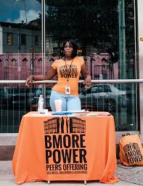
Different models of harm reduction programming
Pharmacy partnership (Frederick)
Mobile units (Baltimore City)
Backpack model (Voices of Hope in Cecil, Bmore POWER)
Notes:
Pharmacy: (+) meet some needs, (-) barrier to getting to pharmacy, less opportunity for relationship building
Backpack: (+) meet where people are, (-) can only carry so much, no privacy, not sterile environment
Mobile: (+) a little more space and privacy, maybe running water, some wrap around services, (-) not consistent location, mechanical or weather troubles

Slide 24
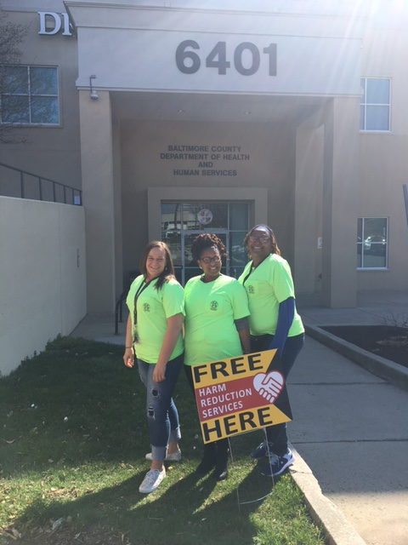
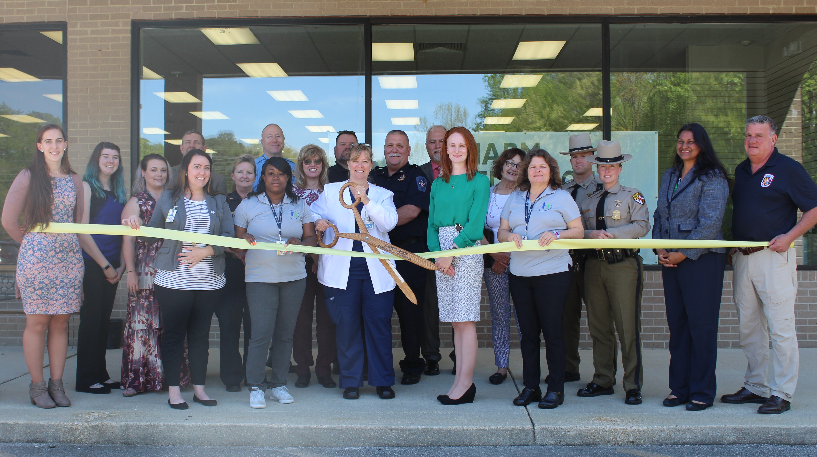
Fixed Site Model
Baltimore County & Cecil County
  Based in health centers
St. Mary’s County
  Drop-in center
Notes:
Relatively new in Maryland, but many counties are advocating to move in this direction

Slide 25

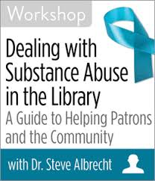
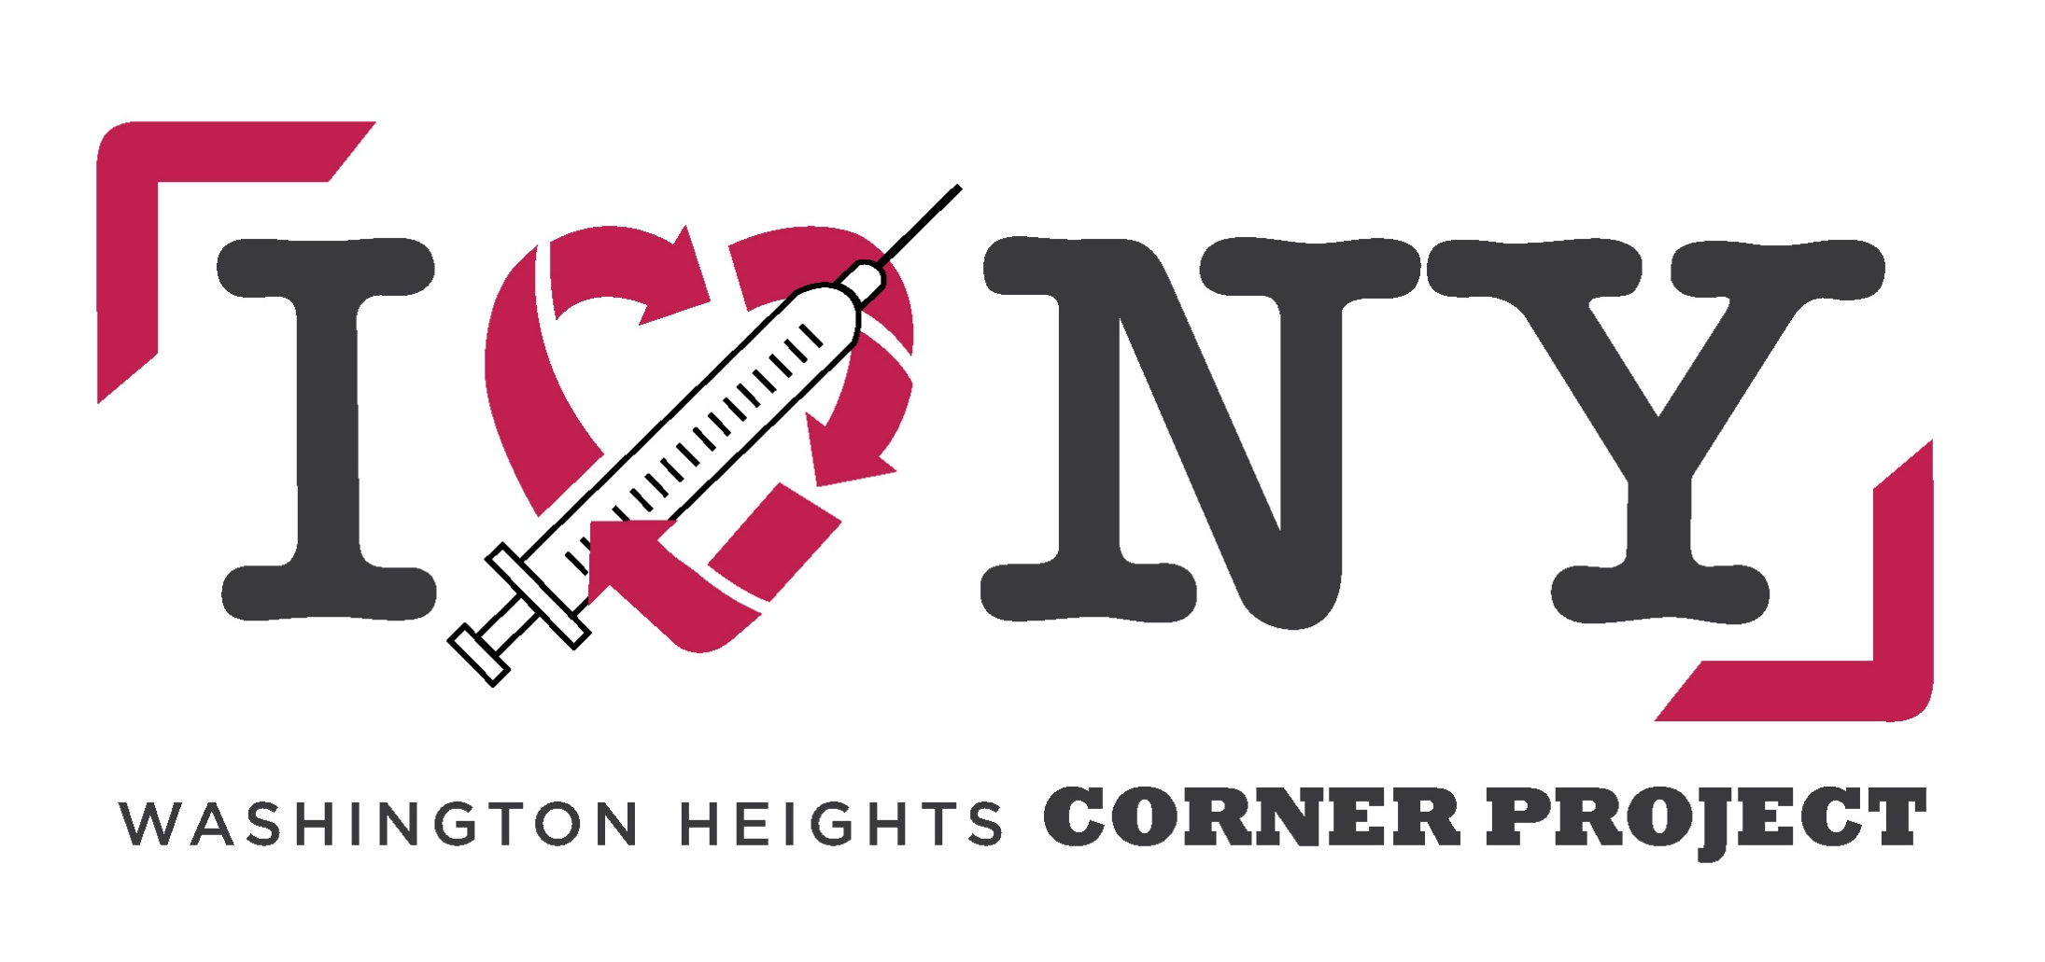

Brick-and-mortar services
Many places encounter people using drugs in their bathroom (because: water, lighting, privacy)
Syringe service programs and others can’t condone it.
But turning people away means that people are sent into the street.
Notes:
In the U.S., these kind of fixed-site services are where the law gets fuzzy… In certain states, including Maryland, fixed-site services are legally allowed to distribute syringes and other works to PWUD… can’t “condone” bathroom usage because that’s illegal

Slide 26
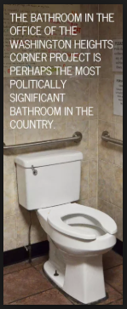
Brick-and-mortar services
Overdose is a real concern
Knock or intercom
Reverse-motion detectors
Buzz lock
Cleanliness & staff safety
Sharps containers
Sanitizing wipes
In 2014, Washington Heights Corner Project in NYC announced publicly that many of their participants use their bathrooms for drug injections, and their organization has saved more than 60 lives from just overdoses that happened in one bathroom.
Notes:
In 2014, Washington Heights Corner Project in NYC announced publicly that many of their participants use their bathrooms for drug injections, and their organization has saved more than 60 lives from just overdoses that happened in one bathroom.

Slide 27
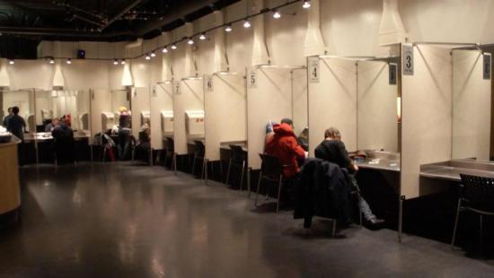
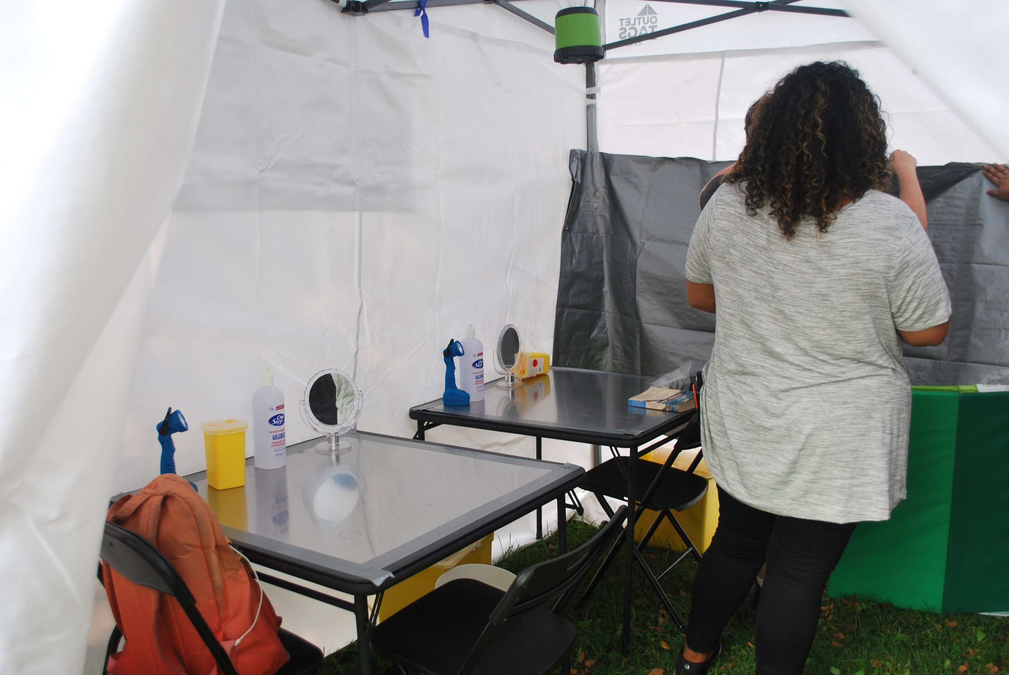
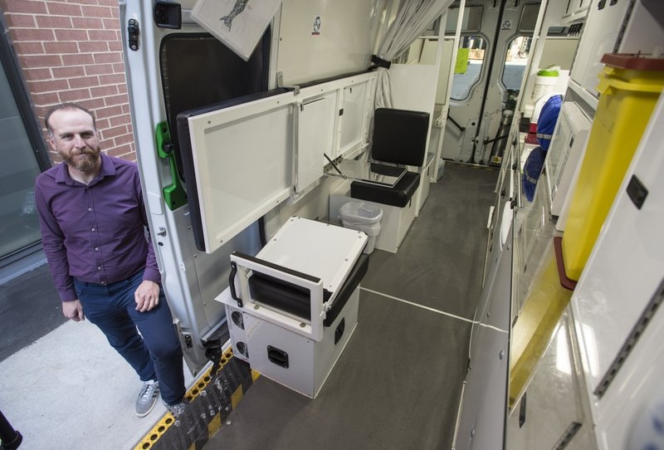
What do you call a syringe service program with chairs?
Notes:
And note the different models here…. Indoor fixed-site; a mobile unit in a van; even an outdoor pop-up tent

Slide 28
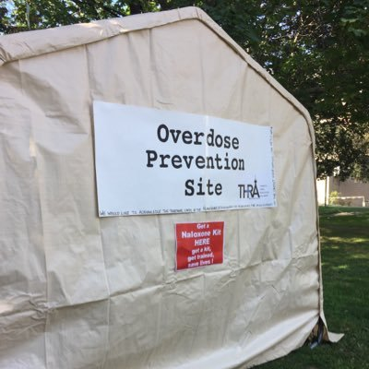
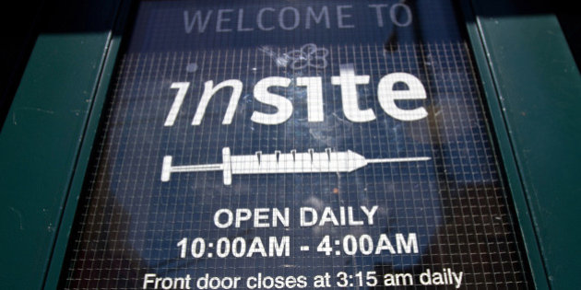
Let the drug use out of the bathrooms (and alleyways, and abandoned houses…)
It’s not hidden anymore.
It’s not just tolerated – it’s legal.
Can talk more openly.
Not increasing access to drugs – just removing penalties and providing a safe space and public health interventions.
Notes:
Now PWUD can open up in a way they couldn’t before and start building therapeutic relationships with staff. They can take their time.
You can’t address a problem that is hidden.

Slide 29
Fundamental to harm reduction
Choice / autonomy
Meet people where they are
People most affected have real voice in policies
“
That’s what all this work is for - to
provide people with a little taste of dignity. Because that can grow into an entire appetite for self-care.
– Cortney Lovell, Young People in Recovery
Notes:
LISA
Recap: It’s important to advocate for different models so that we can meet people where they are, give them access to many choices, and make sure they have a real voice in the creation and implementation of different programs and policies.

Slide 30
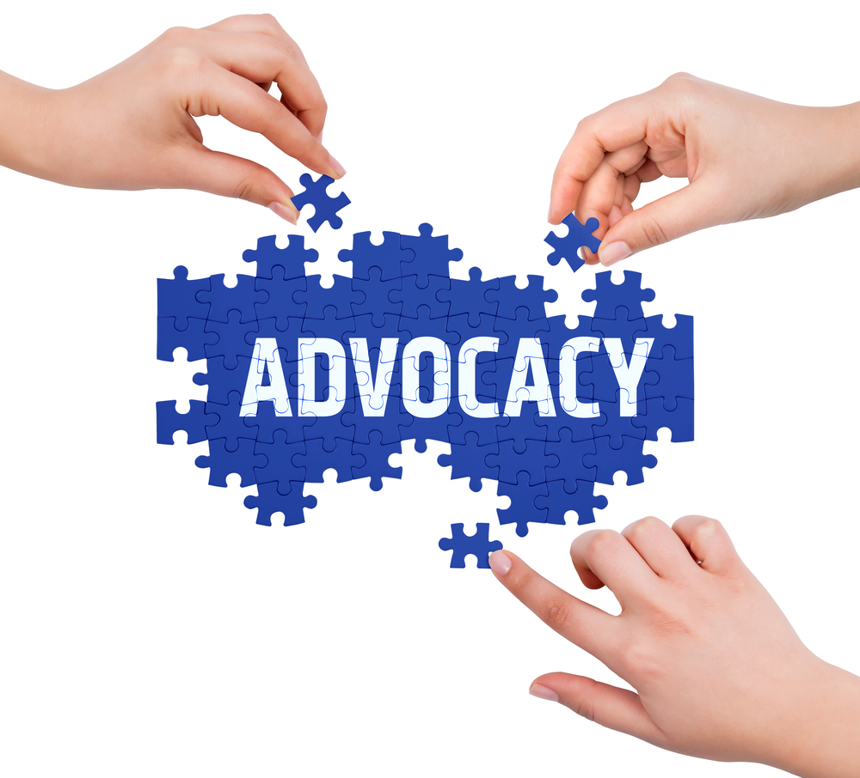
What is advocacy?
“
Advocacy is intended to promote the dignity of, and reduction of stigma against, individuals.
--CPRS advocacy domain training
Notes:
LISA
So now that we’ve told you about a few things that we advocate for, let’s talk about what advocacy looks like.
You all are already harm reductionists!

Slide 31
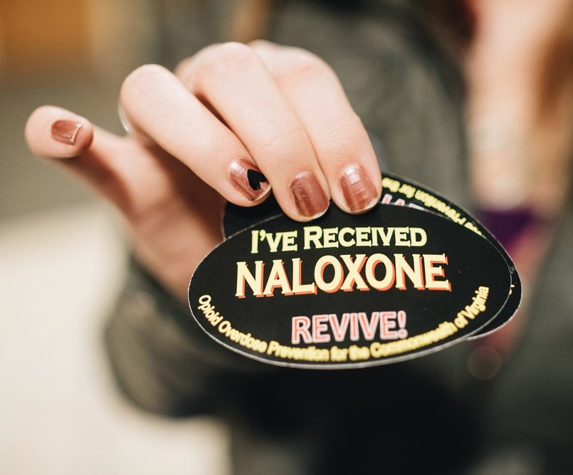
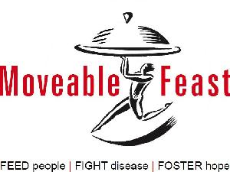
What is advocacy?
Service delivery: Meeting immediate needs
Notes:
LISA
Service delivery: Many of you probably work or volunteer in this capacity

Slide 32
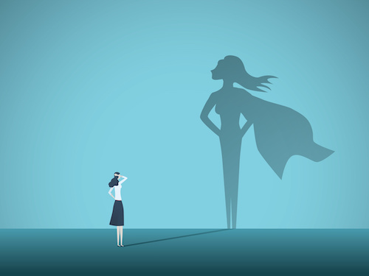
What is advocacy?
Advocating for self or others
Notes:
LISA
As peers, you all know a lot about this already

Slide 33
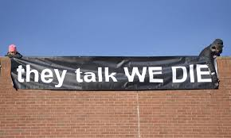
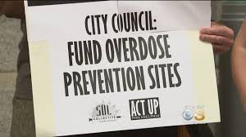
What is advocacy?
Activism: Raising visibility on an issue and challenging systems of power
Notes:
Activism: Sometimes with civil disobedience

Slide 34
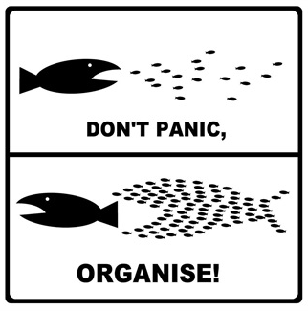
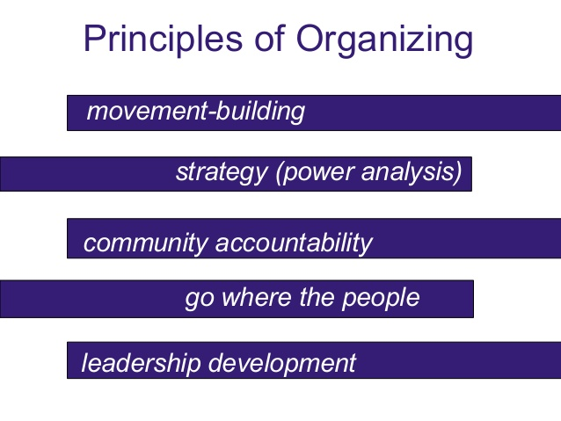
What is advocacy?
Organizing: Turning individual problems into “we” issues rooted in systemic change

Slide 35
Legislative advocacy
All law begins as an idea.
What’s the problem?
Who’s impacted?
What are the possible solutions?
Where do we need to apply pressure to get solutions implemented?
Local (City Hall, County Health Officer, Sheriff, etc.)
State (General Assembly, Opioid Operational Command Center, Maryland Department of Health, etc.)

Slide 36
How a bill becomes a law in MD
Annual 90 day legislative session (mid-Jan to mid-Apr)
2 chambers: House & Senate
Legislator must sponsor the bill
Every bill gets a hearing in committee
  Every bill does not necessarily get
  a vote in committee
If voted favorably in committee, goes to that chamber’s floor session
If voted favorable in floor session, “crosses over” to other chamber (committee then floor)
Talk to legislator about
the problem & solution
Focus initial efforts on
committee members
Focus efforts on leadership
& build up champions

Slide 37
How a bill becomes a law in MD
Both chambers must pass identical legislation before midnight on the last day of Session (Sine Die), or the bill fails
If bill passes both chambers, Governor can always veto
  And sometimes the legislature can vote to overturn that veto
~2,500 bills are introduced each session… ~600 pass
A lot of work happens outside of session!

Slide 38
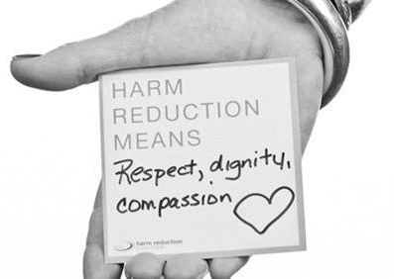
Touchpoints in the system to be an effective advocate
Start at home
Educate friends and family
Organize your peers & local community
Share fact-based information on social media
Attend events and speak up about harm reduction
Notes:
LISA

Slide 39
Touchpoints in the system to be an effective advocate
Get to know your elected officials
Follow them on social media
Attend events and public forums they host
Volunteer on a campaign
Request a meeting
They’re people, too.
They work for you!
their motivations
Getting re-elected
Topics they care about (healthcare, safety, gov’t accountability, etc.)
They’re generalists – you’re the expert!

Slide 40
Touchpoints in the system to be an effective advocate
Working through the media
Earned vs. paid
Letters to the editor & op-eds
  Name the person you are trying to influence
Social media: Click & comment on articles
  Stay on message!
← Reporters are always looking for stories
← Elected officials hate bad press
← News outlets track clicks and will post more about topics that get more attention

Slide 41
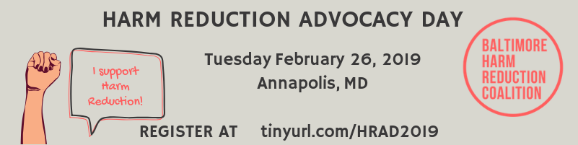
Touchpoints in the system to be an effective advocate
Comment on legislation
Coalition letters
Op-eds
Written or oral testimony for bill hearing
Attend an advocacy day
Call/write/email/meet with your legislators

Slide 42
Story + Talking Point + Ask
Why do you care about this issue ?
What can be done about this issue?
How can the person you are speaking with help?

Slide 43
Be strategic!
Who is already on our side? (Doesn’t need convincing)
Who probably won’t change their mind?
Who is the best messenger?
Don’t get discouraged!
Advocacy -vs- angry debate
You’re the expert!
You might not convince everyone
Notes:
LISA

Slide 44
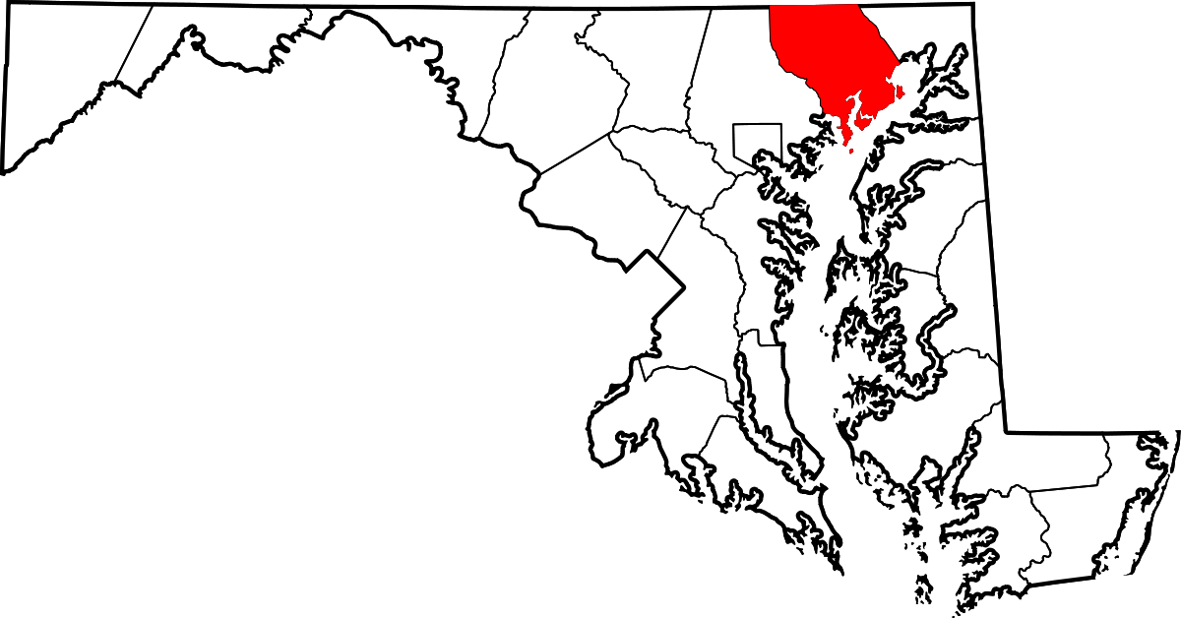
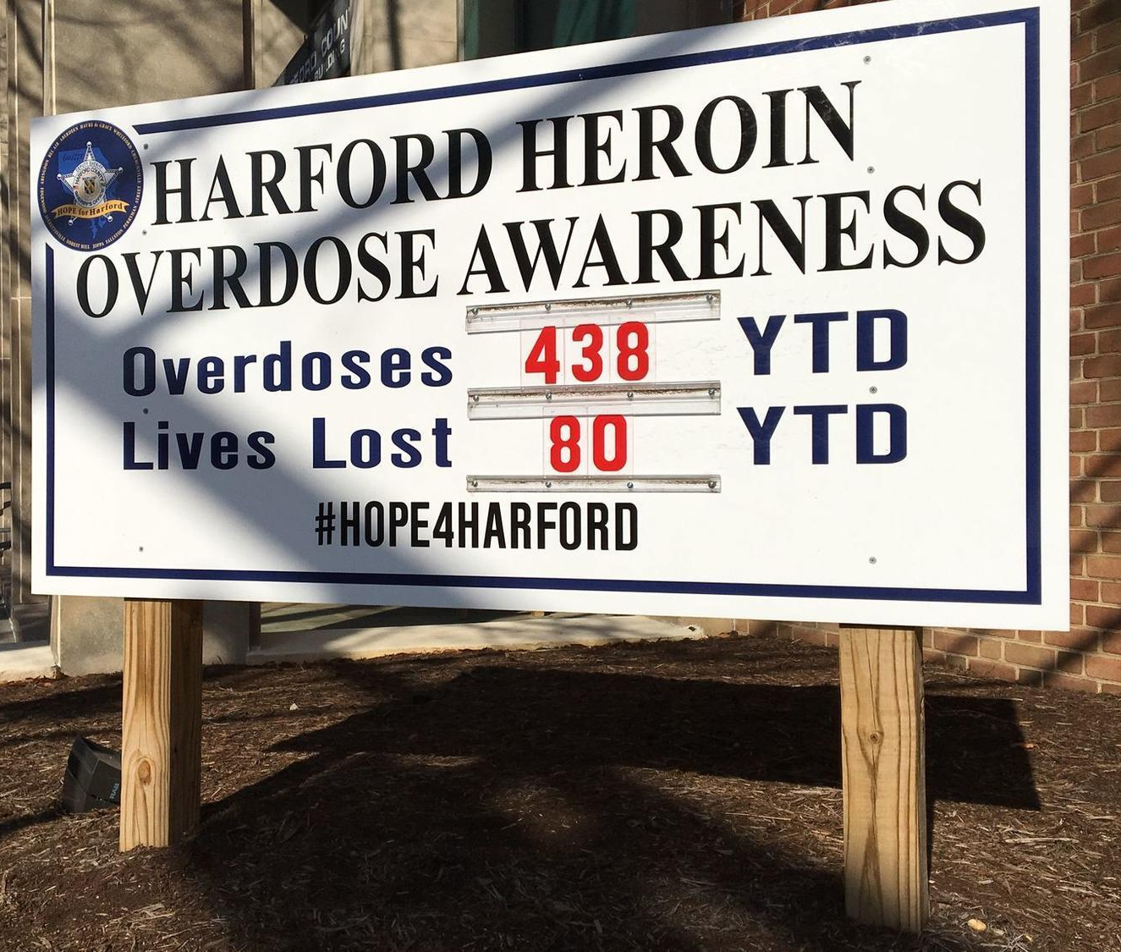
Harford County example
What we know about Harford Co:
Conservative
80% white
Sheriff is outspoken & serious about addressing overdose
Notes:
LISA

Slide 45
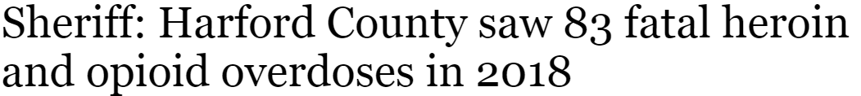

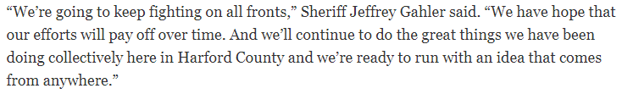

Harford County example

Slide 46
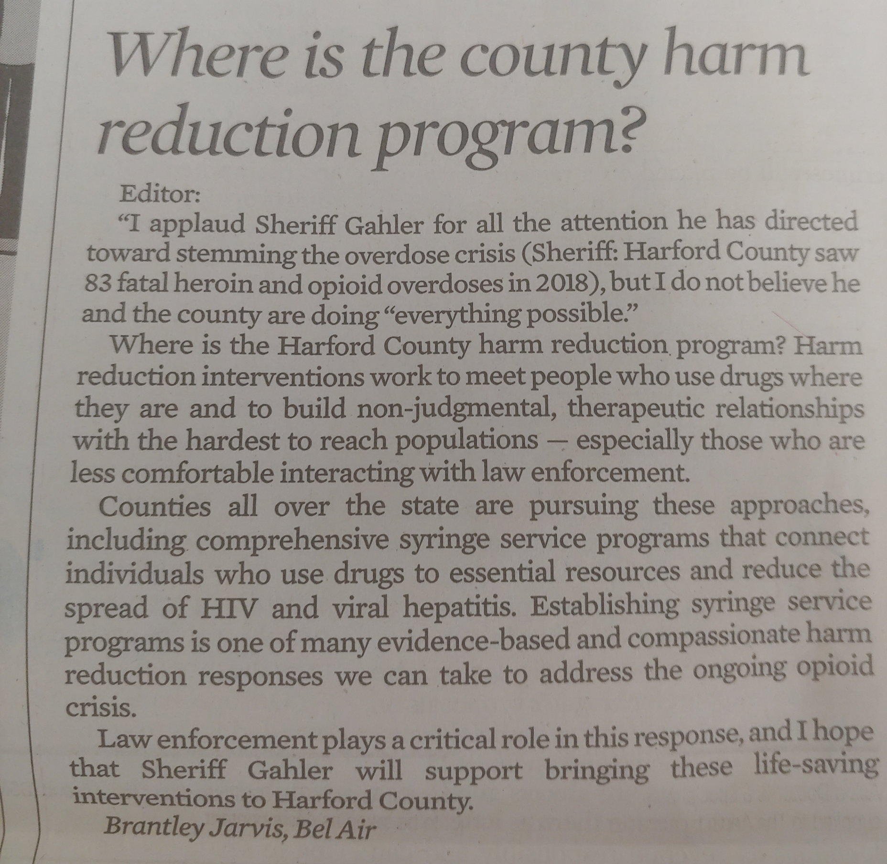
Harford County example
LTE by community member
in The Aegis
February 1, 2019
← Name the person
← Talking point
← Talking point
← Ask

Slide 47
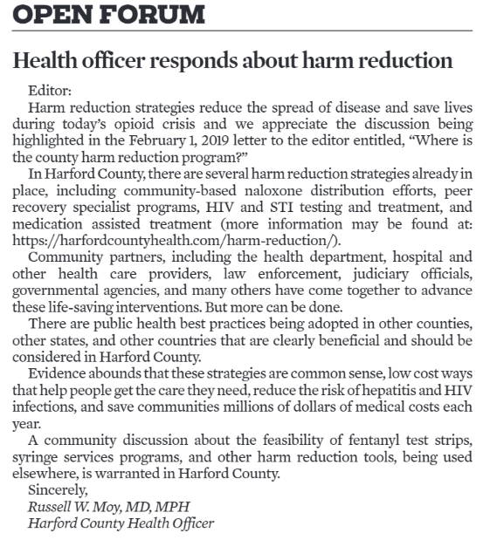
Harford County example
LTE response to LTE by County Health Officer
in The Aegis
February 13, 2019
← Existing harm reduction in county
← “But more can be done.”
← Publicly supports SSP, other tools
Notes:
Good that he labeled current services as harm reduction and how the obvious next step is these other interventions…

Slide 48
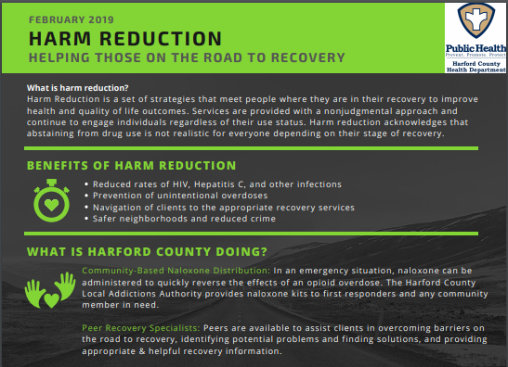
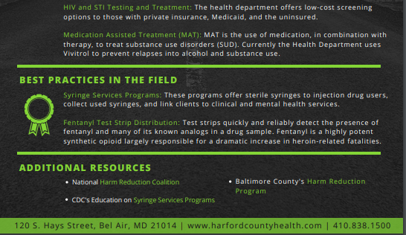
Harford County example
FAQ went live in February

Slide 49

Harford County example
Mid-March: Submitted application for SSP capacity development!
Working on gaining support from local law enforcement, behavioral health stakeholders, etc.
More advocacy will be needed before implementation, but this is great progress.
Notes:
Capacity development = 1st stage before implementation, can take a long time

Slide 50
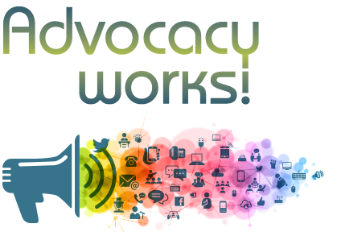
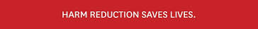
How can I get involved?
Join the Maryland Harm Reduction listserve: tinyurl.com/MDharmredux
Follow Baltimore Harm Reduction Coalition on Facebook: facebook.com/BmoreHRC
Support your local Harm Reduction program!
Host a future Maryland Harm Reduction Action Network (MHRAN) meeting!
Email me: tricia@baltimoreharmreduction.org
Notes:
I’m always looking for harm reduction advocates around the state – Happy to help you with technical assistance to create your own advocacy group, write letters, etc.

